Slide 1
CSCE430/830 Computer Architecture
Memory Hierarchy: Set-Associative Cache
Lecturer: Prof. Hong Jiang
Courtesy of Yifeng Zhu (U. Maine)
Fall, 2006
Portions of these slides are derived from:
Dave Patterson © UCB

Slide 2
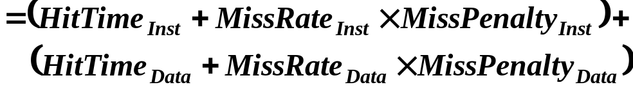
Cache performance
Miss-oriented Approach to Memory Access:
  CPI_{Execution} includes ALU and Memory instructions
Separating out Memory component entirely
  AMAT = Average Memory Access Time
  CPI_{ALUOps} does not include memory instructions

Slide 3
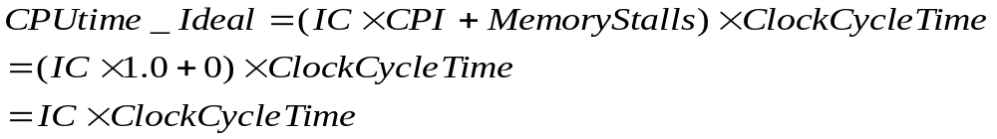
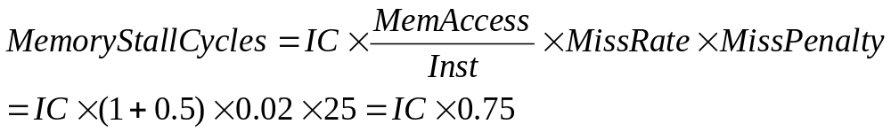
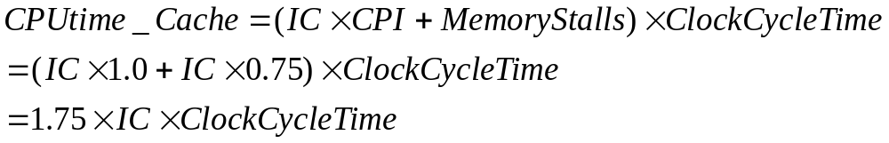
Cache Performance Example
Assume we have a computer where the clock per instruction (CPI) is 1.0 when all memory accesses hit in the cache. The only data accesses are loads and stores, and these total 50% of the instructions. If the miss penalty is 25 clock cycles and the miss rate is 2% (Unified instruction cache and data cache), how much faster would the computer be if all instructions and data were cache hit?
When all instructions are hit
In reality:

Slide 4
Performance Example Problem
Assume:
  For gcc, the frequency for all loads and stores is 36%.
  instruction cache miss rate for gcc = 2%
  data cache miss rate for gcc = 4%.
  If a machine has a CPI of 2 without memory stalls
  and the miss penalty is 40 cycles for all misses,
how much faster is a machine with a perfect cache?
Instruction miss cycles = IC x 2% x 40 = 0.80 x IC
Data miss cycles = IC x 36% x 4% x 40 = 0.576 x IC
CPIstall = 2 + ( 0.80 + 0.567 ) = 2 + 1.376 = 3.376
IC x CPIstall x Clock period 3.376
=
=
1.69
IC x CPIperfect x Clock period 2

Slide 5
Performance Example Problem
Assume: we increase the performance of the previous machine by doubling its clock rate. Since the main memory speed is unlikely to change, assume that the absolute time to handle a cache miss does not change. How much faster will the machine be with the faster clock?
For gcc, the frequency for all loads and stores is 36%
Instruction miss cycles = IC x 2% x 80 = 1.600 x IC
Data miss cycles = IC x 36% x 4% x 80 = 1.152 x IC
2.752 x IC
I x CPI_{slowClk} x Clock period 3.376
I x CPI_{fastClk} x Clock period 4.752 x 0.5
=
= 1.42 (not 2)

Slide 6
Fundamental Questions
Q1: Where can a block be placed in the upper level?
(Block placement)
Q2: How is a block found if it is in the upper level?
(Block identification)
Q3: Which block should be replaced on a miss?
(Block replacement)
Q4: What happens on a write?
(Write strategy)

Slide 7
Q1: Block Placement
Where can block be placed in cache?
  In one predetermined place - direct-mapped
    Use part of address to calculate block location in cache
    Compare cache block with tag to check if block present
  Anywhere in cache - fully associative
    Compare tag to every block in cache
  In a limited set of places - set-associative
    Use portion of address to calculate set (like direct-mapped)
    Place in any block in the set
    Compare tag to every block in set
    Hybrid of direct mapped and fully associative

Slide 8
Direct Mapped Block Placement
Cache
*0
*4
*8
*C
address maps to block:
location = (block address MOD # blocks in cache)
00
04
08
0C
10
14
18
1C
20
24
28
2C
30
34
38
3C
40
44
48
4C
Memory

Slide 9
Example: Accessing A Direct-Mapped Cache
DM cache contains 4 1-word blocks. Find the # Misses for each cache given this sequence of memory block accesses: 0, 8, 0, 6, 8
DM Memory Access 1: Mapping: 0 modulo 4 = 0
Mem Block | DM Hit/Miss
0
Block 0
Block 1
Block 2
Block 3

Slide 10
Example: Accessing A Direct-Mapped Cache
DM cache contains 4 1-word blocks. Find the # Misses for each cache given this sequence of memory block accesses: 0, 8, 0, 6, 8
DM Memory Access 1: Mapping: 0 mod 4 = 0
Mem Block | DM Hit/Miss
0 | miss
Block 0 | Mem[0]
Block 1
Block 2
Block 3
Set 0 is empty: write Mem[0]

Slide 11
Example: Accessing A Direct-Mapped Cache
DM cache contains 4 1-word blocks. Find the # Misses for each cache given this sequence of memory block accesses: 0, 8, 0, 6, 8
DM Memory Access 2: Mapping: 8 mod 4 = 0
Mem Block | DM Hit/Miss
0 | miss
8
Block 0 | Mem[0]
Block 1
Block 2
Block 3

Slide 12
Example: Accessing A Direct-Mapped Cache
DM cache contains 4 1-word blocks. Find the # Misses for each cache given this sequence of memory block accesses: 0, 8, 0, 6, 8
DM Memory Access 2: Mapping: 8 mod 4 = 0
Mem Block | DM Hit/Miss
0 | miss
8 | miss
Block 0 | Mem[8]
Block 1
Block 2
Block 3
Set 0 contains Mem[0]. Overwrite with Mem[8]

Slide 13
Example: Accessing A Direct-Mapped Cache
DM cache contains 4 1-word blocks. Find the # Misses for each cache given this sequence of memory block accesses: 0, 8, 0, 6, 8
DM Memory Access 3: Mapping: 0 mod 4 = 0
Mem Block | DM Hit/Miss
0 | miss
8 | miss
0
Block 0 | Mem[8]
Block 1
Block 2
Block 3

Slide 14
Example: Accessing A Direct-Mapped Cache
DM cache contains 4 1-word blocks. Find the # Misses for each cache given this sequence of memory block accesses: 0, 8, 0, 6, 8
DM Memory Access 3: Mapping: 0 mod 4 = 0
Mem Block | DM Hit/Miss
0 | miss
8 | miss
0 | miss
Block 0 | Mem[0]
Block 1
Block 2
Block 3
Set 0 contains Mem[8]. Overwrite with Mem[0]

Slide 15
Example: Accessing A Direct-Mapped Cache
DM cache contains 4 1-word blocks. Find the # Misses for each cache given this sequence of memory block accesses: 0, 8, 0, 6, 8
DM Memory Access 4: Mapping: 6 mod 4 = 2
Mem Block | DM Hit/Miss
0 | miss
8 | miss
0 | miss
6
Block 0 | Mem[0]
Block 1
Block 2
Block 3

Slide 16
Example: Accessing A Direct-Mapped Cache
DM cache contains 4 1-word blocks. Find the # Misses for each cache given this sequence of memory block accesses: 0, 8, 0, 6, 8
DM Memory Access 4: Mapping: 6 mod 4 = 2
Mem Block | DM Hit/Miss
0 | miss
8 | miss
0 | miss
6 | miss
Block 0 | Mem[0]
Block 1
Block 2 | Mem[6]
Block 3
Set 2 empty. Write Mem[6]

Slide 17
Example: Accessing A Direct-Mapped Cache
DM cache contains 4 1-word blocks. Find the # Misses for each cache given this sequence of memory block accesses: 0, 8, 0, 6, 8
DM Memory Access 5: Mapping: 8 mod 4 = 0
Mem Block | DM Hit/Miss
0 | miss
8 | miss
0 | miss
6 | miss
8
Block 0 | Mem[0]
Block 1
Block 2 | Mem[6]
Block 3

Slide 18
Example: Accessing A Direct-Mapped Cache
DM cache contains 4 1-word blocks. Find the # Misses for each cache given this sequence of memory block accesses: 0, 8, 0, 6, 8
DM Memory Access 5: Mapping: 8 mod 4 = 0
Mem Block | DM Hit/Miss
0 | miss
8 | miss
0 | miss
6 | miss
8 | miss
Block 0 | Mem[8]
Block 1
Block 2 | Mem[6]
Block 3
Set 0 contains Mem[0]. Overwrite with Mem[8]

Slide 19
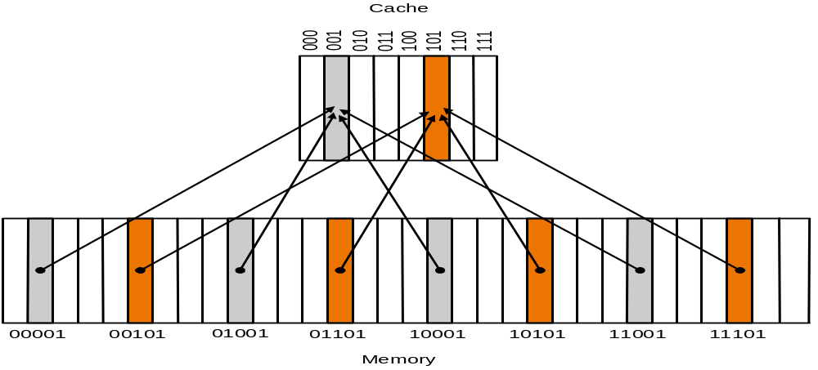
Direct-Mapped Cache with n one-word blocks
Pros: find data fast
Con: What if access 00001 and 10001 repeatedly?
→ We always miss…

Slide 20
Fully Associative Block Placement
Cache
arbitrary block mapping
location = any
00
04
08
0C
10
14
18
1C
20
24
28
2C
30
34
38
3C
40
44
48
4C
Memory

Slide 21
Example: Accessing A Fully-Associative Cache
Fully-Associative cache contains 4 1-word blocks. Find the # Misses for each cache given this sequence of memory block accesses: 0, 8, 0, 6, 8
FA Memory Access 1:
Mem Block | DM Hit/Miss
0
S e t 0
FA Block Replacement Rule: replace least recently used block in set

Slide 22
Example: Accessing A Fully-Associative Cache
Fully-Associative cache contains 4 1-word blocks. Find the # Misses for each cache given this sequence of memory block accesses: 0, 8, 0, 6, 8
FA Memory Access 1:
Mem Block | DM Hit/Miss
0 | miss
S e t 0 | Mem [0]
Set 0 is empty: write Mem[0] to Block 0

Slide 23
Example: Accessing A Fully-Associative Cache
Fully-Associative cache contains 4 1-word blocks. Find the # Misses for each cache given this sequence of memory block accesses: 0, 8, 0, 6, 8
FA Memory Access 2:
Mem Block | DM Hit/Miss
0 | miss
8
S e t 0 | Mem [0]

Slide 24
Example: Accessing A Fully-Associative Cache
Fully-Associative cache contains 4 1-word blocks. Find the # Misses for each cache given this sequence of memory block accesses: 0, 8, 0, 6, 8
FA Memory Access 2:
Mem Block | DM Hit/Miss
0 | miss
8 | miss
S e t 0 | Mem [0] | Mem [8]
Blocks 1-3 are LRU: write Mem[8] to Block 1

Slide 25
Example: Accessing A Fully-Associative Cache
Fully-Associative cache contains 4 1-word blocks. Find the # Misses for each cache given this sequence of memory block accesses: 0, 8, 0, 6, 8
FA Memory Access 3:
Mem Block | DM Hit/Miss
0 | miss
8 | miss
0
S e t 0 | Mem [0] | Mem [8]

Slide 26
Example: Accessing A Fully-Associative Cache
Fully-Associative cache contains 4 1-word blocks. Find the # Misses for each cache given this sequence of memory block accesses: 0, 8, 0, 6, 8
FA Memory Access 3:
Mem Block | DM Hit/Miss
0 | miss
8 | miss
0 | hit
S e t 0 | Mem [0] | Mem [8]
Block 0 contains Mem[0]

Slide 27
Example: Accessing A Fully-Associative Cache
Fully-Associative cache contains 4 1-word blocks. Find the # Misses for each cache given this sequence of memory block accesses: 0, 8, 0, 6, 8
FA Memory Access 4:
Mem Block | DM Hit/Miss
0 | miss
8 | miss
0 | hit
6
S e t 0 | Mem [0] | Mem [8]

Slide 28
Example: Accessing A Fully-Associative Cache
Fully-Associative cache contains 4 1-word blocks. Find the # Misses for each cache given this sequence of memory block accesses: 0, 8, 0, 6, 8
FA Memory Access 4:
Mem Block | DM Hit/Miss
0 | miss
8 | miss
0 | hit
6 | miss
S e t 0 | Mem [0] | Mem [8] | Mem [6]
Blocks 2-3 are LRU : write Mem[6] to Block 2

Slide 29
Example: Accessing A Fully-Associative Cache
Fully-Associative cache contains 4 1-word blocks. Find the # Misses for each cache given this sequence of memory block accesses: 0, 8, 0, 6, 8
FA Memory Access 5:
Mem Block | DM Hit/Miss
0 | miss
8 | miss
0 | hit
6 | miss
8
S e t 0 | Mem [0] | Mem [8] | Mem [6]

Slide 30
Example: Accessing A Fully-Associative Cache
Fully-Associative cache contains 4 1-word blocks. Find the # Misses for each cache given this sequence of memory block accesses: 0, 8, 0, 6, 8
FA Memory Access 5:
Mem Block | DM Hit/Miss
0 | miss
8 | miss
0 | hit
6 | miss
8 | hit
S e t 0 | Mem [0] | Mem [8] | Mem [6]
Block 1 contains Mem[8]

Slide 31
Fully-Associative Cache Basics
1 set, n blocks: no mapping restrictions on how blocks are stored in cache: many ways, e.g. least recently used is replaced (LRU)
0…0000
0…0001
0…0010
0…0011
0…0100
0…0101
0…0110
0…0111
0…1000
0…1001
0…1010
0…1011
0…1100
0…1101
0…1110
0…1111
…
Example: 1-set, 8-block FA cache
Set 0 | Block 0 | Block 1 | Block 2 | Block 3 | Block 4 | Block 5 | Block 6 | Block 7
PRO:
CON:
Less likely to replace needed data
Must search entire cache for hit/miss

Slide 32
Set-Associative Block Placement
Cache
*0
*0
*4
*4
*8
*8
*C
*C
address maps to set:
location = (block address MOD # sets in cache)
(arbitrary location in set)
Set 0
Set 1
Set 2
Set 3
00
04
08
0C
10
14
18
1C
20
24
28
2C
30
34
38
3C
40
44
48
4C
Memory

Slide 33
Set-Associative Cache Basics
n/m sets, m blocks (m-way): blocks are mapped from memory location to a specific set in cache
Mapping: Mem Address % n/m. If n/m is
a power of 2, log2(n/m) = #low-order bits
of memory address = cache set index
0…0000 | Mem block 0
0…0001
0…0010
0…0011
0…0100
0…0101
0…0110
0…0111
0…1000 | Mem block 8
0…1001
0…1010
0…1011
0…1100
0…1101
0…1110
0…1111
…
Example: 4 set, 2-way SA cache (ADD mod 4)
Set 00 | Block 0 | Block 1
Set 01
Set 10
Set 11

Slide 34
Example: Accessing A Set-Associative Cache
2-way Set-Associative cache contains 2 sets, 2 one-word blocks each. Find the # Misses for each cache given this sequence of memory block accesses: 0, 8, 0, 6, 8
SA Memory Access 1: Mapping: 0 mod 2 = 0
Mem Block | DM Hit/Miss
0
Set 0
Set 1
SA Block Replacement Rule: replace least recently used block in set

Slide 35
Example: Accessing A Set-Associative Cache
2-way Set-Associative cache contains 2 sets, 2 one-word blocks each. Find the # Misses for each cache given this sequence of memory block accesses: 0, 8, 0, 6, 8
SA Memory Access 1: Mapping: 0 mod 2 = 0
Mem Block | DM Hit/Miss
0 | miss
Set 0 | Mem[0]
Set 1
Set 0 is empty: write Mem[0] to Block 0

Slide 36
Example: Accessing A Set-Associative Cache
2-way Set-Associative cache contains 2 sets, 2 one-word blocks each. Find the # Misses for each cache given this sequence of memory block accesses: 0, 8, 0, 6, 8
SA Memory Access 2: Mapping: 8 mod 2 = 0
Mem Block | DM Hit/Miss
0 | miss
8
Set 0 | Mem[0]
Set 1

Slide 37
Example: Accessing A Set-Associative Cache
2-way Set-Associative cache contains 2 sets, 2 one-word blocks each. Find the # Misses for each cache given this sequence of memory block accesses: 0, 8, 0, 6, 8
SA Memory Access 2: Mapping: 8 mod 2 = 0
Mem Block | DM Hit/Miss
0 | miss
8 | miss
Set 0 | Mem[0] | Mem[8]
Set 1
Set 0, Block 1 is LRU: write Mem[8]

Slide 38
Example: Accessing A Set-Associative Cache
2-way Set-Associative cache contains 2 sets, 2 one-word blocks each. Find the # Misses for each cache given this sequence of memory block accesses: 0, 8, 0, 6, 8
SA Memory Access 3: Mapping: 0 mod 2 = 0
Mem Block | DM Hit/Miss
0 | miss
8 | miss
0
Set 0 | Mem[0] | Mem[8]
Set 1

Slide 39
Example: Accessing A Set-Associative Cache
2-way Set-Associative cache contains 2 sets, 2 one-word blocks each. Find the # Misses for each cache given this sequence of memory block accesses: 0, 8, 0, 6, 8
SA Memory Access 3: Mapping: 0 mod 2 = 0
Mem Block | DM Hit/Miss
0 | miss
8 | miss
0 | hit
Set 0 | Mem[0] | Mem[8]
Set 1
Set 0, Block 0 contains Mem[0]

Slide 40
Example: Accessing A Set-Associative Cache
2-way Set-Associative cache contains 2 sets, 2 one-word blocks each. Find the # Misses for each cache given this sequence of memory block accesses: 0, 8, 0, 6, 8
SA Memory Access 4: Mapping: 6 mod 2 = 0
Mem Block | DM Hit/Miss
0 | miss
8 | miss
0 | hit
6
Set 0 | Mem[0] | Mem[8]
Set 1

Slide 41
Example: Accessing A Set-Associative Cache
2-way Set-Associative cache contains 2 sets, 2 one-word blocks each. Find the # Misses for each cache given this sequence of memory block accesses: 0, 8, 0, 6, 8
SA Memory Access 4: Mapping: 6 mod 2 = 0
Mem Block | DM Hit/Miss
0 | miss
8 | miss
0 | hit
6 | miss
Set 0 | Mem[0] | Mem[6]
Set 1
Set 0, Block 1 is LRU: overwrite with Mem[6]

Slide 42
Example: Accessing A Set-Associative Cache
2-way Set-Associative cache contains 2 sets, 2 one-word blocks each. Find the # Misses for each cache given this sequence of memory block accesses: 0, 8, 0, 6, 8
SA Memory Access 5: Mapping: 8 mod 2 = 0
Mem Block | DM Hit/Miss
0 | miss
8 | miss
0 | hit
6 | miss
8
Set 0 | Mem[0] | Mem[6]
Set 1

Slide 43
Example: Accessing A Set-Associative Cache
2-way Set-Associative cache contains 2 sets, 2 one-word blocks each. Find the # Misses for each cache given this sequence of memory block accesses: 0, 8, 0, 6, 8
SA Memory Access 5: Mapping: 8 mod 2 = 0
Mem Block | DM Hit/Miss
0 | miss
8 | miss
0 | hit
6 | miss
8 | miss
Set 0 | Mem[8] | Mem[6]
Set 1
Set 0, Block 0 is LRU: overwrite with Mem[8]

Slide 44
Set-Associative Cache Basics
n/m sets, m blocks (m-way): blocks are mapped from memory location to a specific set in cache
Mapping: Mem Address % n/m. If n/m is
a power of 2, log2(n/m) = #low-order bits
of memory address = cache set index
0…0000 | Mem block 0
0…0001
0…0010
0…0011
0…0100
0…0101
0…0110
0…0111
0…1000 | Mem block 8
0…1001
0…1010
0…1011
0…1100
0…1101
0…1110
0…1111
…
Example: 4 set, 2-way SA cache (X mod 4)
PRO:
Set 00 | Block 0 | Block 1
Set 01
Set 10
Set 11
Easier to find but won’t always overwrite
Must search set for hit/miss
CON:

Slide 45
Associativity Considerations
DM and FA are special cases of SA cache
  Set-Associative: n/m sets; m blocks/set (associativity=m)
  Direct-Mapped: m=1 (1-way set-associative, associativity=1)
  Fully-Associative: m=n (n-way set-associative, associativity=n)
Advantage of Associativity: as associativity increases, miss rate decreases (because more blocks per set that we’re less likely to overwrite)
Disadvantage of Associativity: as associativity increases, hit time increases (because we have to search more blocks – more HW required)
Block Replacement: LRU or random. Random is easier to implement and often not much worse

Slide 46
Q2: Block Identification
Every cache block has an address tag that identifies its location in memory
Hit when tag and address of desired word match
(comparison by hardware)
Q: What happens when a cache block is empty?
A: Mark this condition with a valid bit (0 if empty)
Valid
Tag
Data
1
0x00001C0
0xff083c2d

Slide 47
Q2: Block Identification?
Tag on each block
  No need to check index or block offset
Increasing associativity shrinks index, expands tag
Block Address
Block Offset
Tag
Index
Fully Associative: No index
Direct Mapped: Large index

Slide 48
Direct-Mapped Cache Design
ADDRESS
Tag
Cache
Index
Byte Offset
DATA
HIT
=1
0x0000000
3
0
ADDR
CACHE SRAM
V
Tag
Data
1
0x00001C0
0xff083c2d
0
1
0x0000000
0x00000021
1
0x0000000
0x00000103
0
0
1
0
0x23F0210
0x00000009
DATA[59]
DATA[58:32]
DATA[31:0]
=

Slide 49
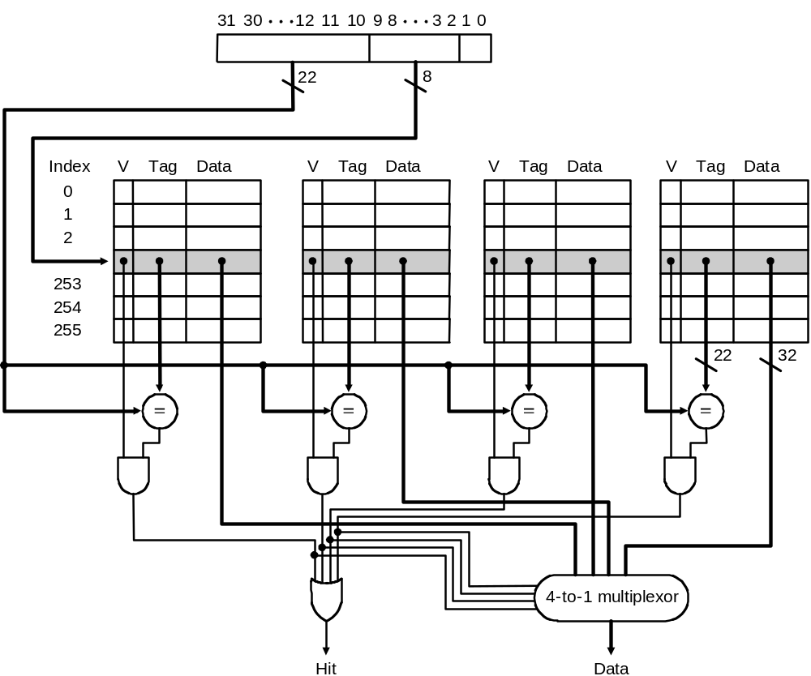
Set Associative Cache Design
Key idea:
  Divide cache into sets
  Allow block anywhere in a set
Advantages:
  Better hit rate
Disadvantage:
  More tag bits
  More hardware
  Higher access time
A Four-Way Set-Associative Cache

Slide 50
Fully Associative Cache Design
Key idea: set size of one block
  1 comparator required for each block
  No address decoding
  Practical only for small caches due to hardware demands
tag in 11110111
data out 1111000011110000101011
=
tag 00011100
data 0000111100001111111101
=
=
tag 11110111
data 1111000011110000101011
tag 11110111
data 1111000011110000101011
=
tag 11111110
data 0000000000001111111100
=
tag 00000011
data 1110111100001110000001
=
tag 11100110
data 1111111111111111111111

Slide 51
Calculating Bits in Cache
How many total bits are needed for a direct- mapped cache with 64 KBytes of data and one word blocks, assuming a 32-bit address?
How many total bits would be needed for a 4-way set associative cache to store the same amount of data
How many total bits are needed for a direct- mapped cache with 64 KBytes of data and 8 word blocks, assuming a 32-bit address?

Slide 52
Calculating Bits in Cache
How many total bits are needed for a direct- mapped cache with 64 KBytes of data and one word blocks, assuming a 32-bit address?
  64 Kbytes = 16 K words = 2^14 words = 2^14 blocks
  block size = 4 bytes => offset size = 2 bits,
  #sets = #blocks = 2^14 => index size = 14 bits
  tag size = address size - index size - offset size = 32 - 14 - 2 = 16 bits
  bits/block = data bits + tag bits + valid bit = 32 + 16 + 1 = 49
  bits in cache = #blocks x bits/block = 2^14 x 49 = 98 Kbytes
How many total bits would be needed for a 4-way set associative cache to store the same amount of data
  block size and #blocks does not change
  #sets = #blocks/4 = (2^14)/4 = 2^12 => index size = 12 bits
  tag size = address size - index size - offset = 32 - 12 - 2 = 18 bits
  bits/block = data bits + tag bits + valid bit = 32 + 18 + 1 = 51
  bits in cache = #blocks x bits/block = 2^14 x 51 = 102 Kbytes
Increase associativity => increase bits in cache

Slide 53
Calculating Bits in Cache
How many total bits are needed for a direct- mapped cache with 64 KBytes of data and 8 word blocks, assuming a 32-bit address?
  64 Kbytes = 2^14 words = (2^14)/8 = 2^11 blocks
  block size = 32 bytes => offset size = 5 bits,
  #sets = #blocks = 2^11 => index size = 11 bits
  tag size = address size - index size - offset size = 32 - 11 - 5 = 16 bits
  bits/block = data bits + tag bits + valid bit = 8x32 + 16 + 1 = 273 bits
  bits in cache = #blocks x bits/block = 2^11 x 273 = 68.25 Kbytes
Increase block size => decrease bits in cache

Slide 54
Q3: Block Replacement
On a miss, data must be read from memory.
So, where do we put the new data?
  Direct-mapped cache: must place in fixed location
  Set-associative, fully-associative - can pick within set

Slide 55
Replacement Algorithms
When a block is fetched, which block in the target set should be replaced?
Optimal algorithm:
    replace the block that will not be used for the longest time (must know the future)
Usage based algorithms:
  Least recently used (LRU)
    replace the block that has been referenced least recently
    hard to implement
Non-usage based algorithms:
  First-in First-out (FIFO)
    treat the set as a circular queue, replace head of queue.
    easy to implement
  Random (RAND)
    replace a random block in the set
    even easier to implement

Slide 56
Q4: Write Strategy
What happens on a write?
  Write through - write to memory, stall processor until done
  Write buffer - place in buffer (allows pipeline to continue*)
  Write back - delay write to memory until block is replaced in cache
Special considerations when using DMA, multiprocessors (coherence between caches)

Slide 57
Write Through
Store by processor updates cache and memory
Memory always consistent with cache
~2X more loads than stores
WT always combined with write buffers so that don’t wait for lower level memory
Memory
Store
Processor
Cache
Load
Cache
Load

Slide 58
Write Back
Store by processor only updates cache line
Modified line written to memory only when it is evicted
  Requires “dirty bit” for each line
    Set when line in cache is modified
    Indicates that line in memory is stale
Memory not always consistent with cache
No writes of repeated writes
Processor
Write
Back
Memory
Store
Cache
Load
Cache
Load

Slide 59
Store Miss?
Write-Allocate
  Bring written block into cache
  Update word in block
  Anticipate further use of block
No-write Allocate
  Main memory is updated
  Cache contents unmodified

Slide 60
Cache Basics
Cache: level of temporary memory storage between CPU and main memory. Improves overall memory speed by taking advantage of the principle of locality
Cache is divided into sets; each set holds from a particular group of main memory locations
Cache parameters
  Cache size, block size, associativity
3 types of Cache (w/ n total blocks):
  Direct-mapped: n sets, each holds 1 block
  Fully-associative: 1 set, holds n blocks
  Set-associative: n/m sets, each holds m blocks

Slide 61
Classifying Misses: 3C
  Compulsory—The first access to a block is not in the cache, so the block must be brought into the cache. Also called cold start misses or first reference misses.
  (Misses in even an Infinite Cache)
  Capacity—If the cache cannot contain all the blocks needed during execution of a program, capacity misses will occur due to blocks being discarded and later retrieved.
  (Misses in Fully Associative Size X Cache)
  Conflict—If block-placement strategy is set associative or direct mapped, conflict misses (in addition to compulsory & capacity misses) will occur because a block can be discarded and later retrieved if too many blocks map to its set. Also called collision misses or interference misses.
  (Misses in N-way Associative, Size X Cache)

Slide 62
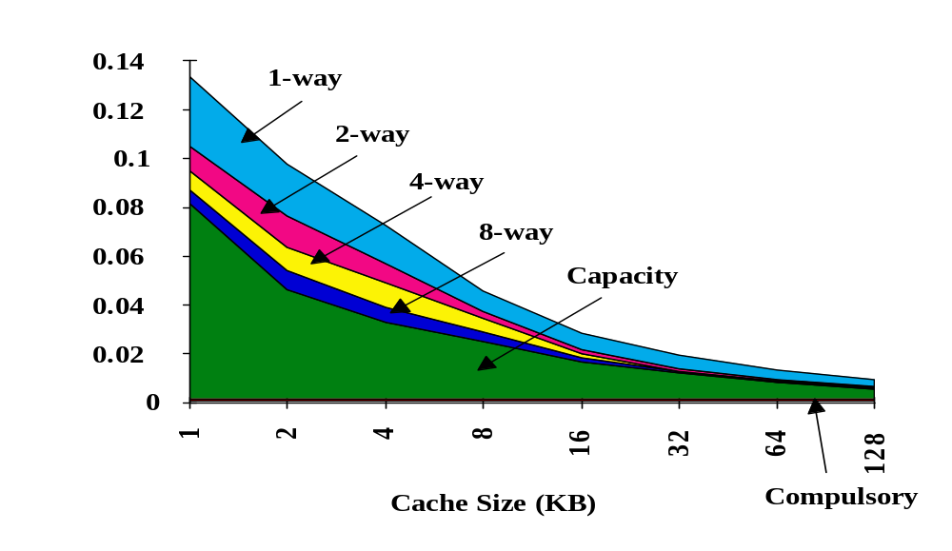
3Cs Absolute Miss Rate (SPEC92)
Classifying Misses: 3C
Conflict
Compulsory vanishingly
small

Slide 63
2:1 Cache Rule
miss rate 1-way associative cache size X
= miss rate 2-way associative cache size X/2
Conflict

Slide 64
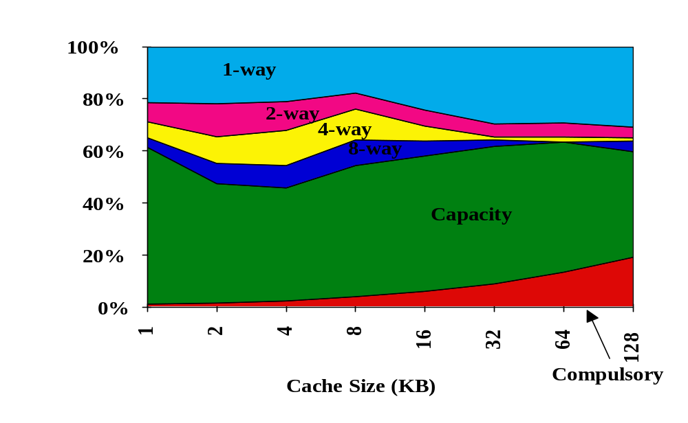
3C Relative Miss Rate
Conflict
Flaws: for fixed block size
Good: insight => invention

Slide 65
Improve Cache Performance
improve cache and memory access times:
Average Memory Access Time = Hit Time + Miss Rate * Miss Penalty
Section 5.5
Section 5.3
Section 5.4
Improve performance by:
1. Reduce the miss rate,
2. Reduce the miss penalty, or
3. Reduce the time to hit in the cache.

Slide 66
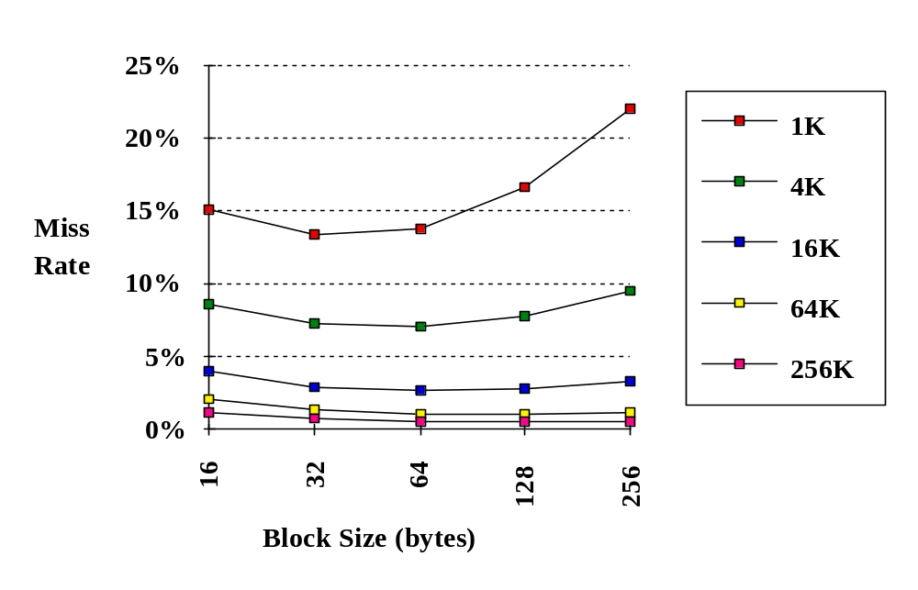
Reducing Cache Misses: 1. Larger Block Size
Using the principle of locality. The larger the block, the greater the chance parts of it will be used again.
Size of Cache

Slide 67
Increasing Block Size
One way to reduce the miss rate is to increase the block size
  Take advantage of spatial locality
  Decreases compulsory misses
However, larger blocks have disadvantages
  May increase the miss penalty (need to get more data)
  May increase hit time (need to read more data from cache and larger mux)
  May increase miss rate, since conflict misses
Increasing the block size can help, but don’t overdo it.

Slide 68

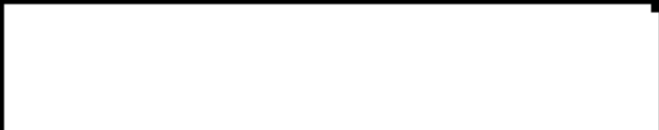
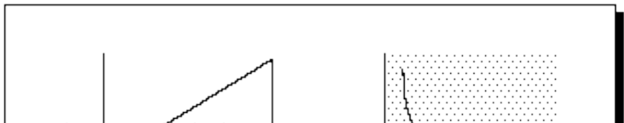


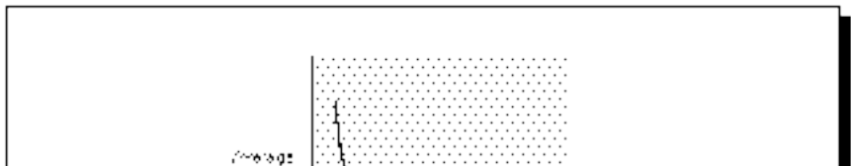
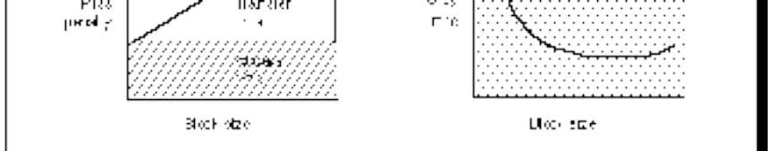




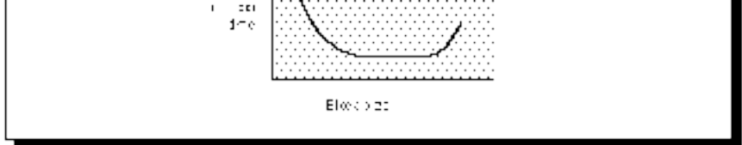
Block Size vs. Cache Measures
Increasing Block Size generally increases Miss Penalty and decreases Miss Rate
As the block size increases the AMAT starts to decrease, but eventually increases
Miss
Penalty
X
Miss
Rate
=
Avg.
Memory
Access
Time
Block Size
Block Size
Block Size

Slide 69
Reducing Cache Misses: 2. Higher Associativity
Increasing associativity helps reduce conflict misses
2:1 Cache Rule:
  The miss rate of a direct mapped cache of size N is about equal to the miss rate of a 2-way set associative cache of size N/2
  For example, the miss rate of a 32 Kbyte direct mapped cache is about equal to the miss rate of a 16 Kbyte 2-way set associative cache
Disadvantages of higher associativity
  Need to do large number of comparisons
  Need n-to-1 multiplexor for n-way set associative
  Could increase hit time

Slide 70
AMAT vs. Associativity
Cache Size Associativity
(KB) 1-way 2-way 4-way 8-way
1 7.65 6.60 6.22 5.44
2 5.90 4.90 4.62 4.09
4 4.60 3.95 3.57 3.19
8 3.30 3.00 2.87 2.59
16 2.45 2.20 2.12 2.04
32 2.00 1.80 1.77 1.79
64 1.70 1.60 1.57 1.59
128 1.50 1.45 1.42 1.44
Red means A.M.A.T. not improved by more associativity
Does not take into account effect of slower clock on rest of program

Slide 71
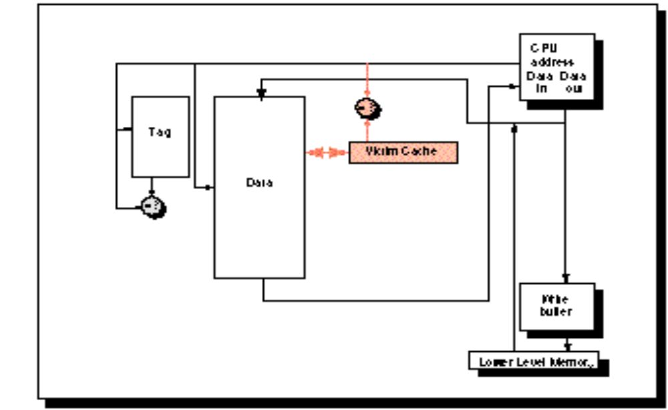
Reducing Cache Misses: 3. Victim Cache
Data discarded from cache is placed in an extra small buffer (victim cache).
On a cache miss check victim cache for data before going to main memory
Jouppi [1990]: A 4-entry victim cache removed 20% to 95% of conflicts for a 4 KB direct mapped data cache
Used in Alpha, HP PA-RISC CPUs.
CPU
Address
In
Out
Address
=?
Tag
Victim Cache
Data
Cache
=?
Write
Buffer
Lower Level Memory

Slide 72
Reducing Cache Misses:
4. Way Prediction and Pseudoassociative Caches
  Way prediction helps select one block among those in a set, thus requiring only one tag comparison (if hit).
    Preserves advantages of direct-mapping (why?);
    In case of a miss, other block(s) are checked.
  Pseudoassociative (also called column associative) caches
    Operate exactly as direct-mapping caches when hit, thus again preserving advantages of the direct-mapping;
    In case of a miss, another block is checked (as if in set-associative caches), by simply inverting the most significant bit of the index field to find the other block in the “pseudoset”.
    real hit time < pseudo-hit time
    too many pseudo hits would defeat the purpose

Slide 73
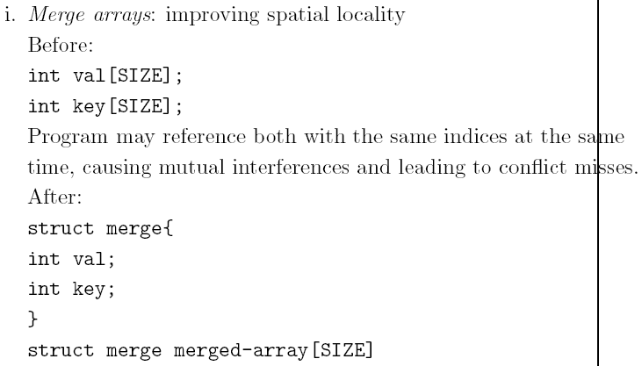
Reducing Cache Misses:
5. Compiler Optimizations

Slide 74
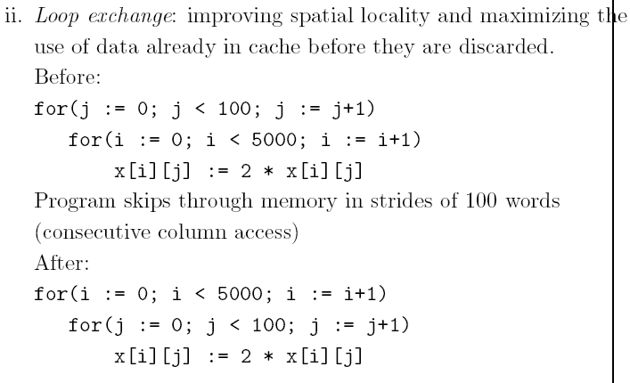
Reducing Cache Misses:
5. Compiler Optimizations

Slide 75
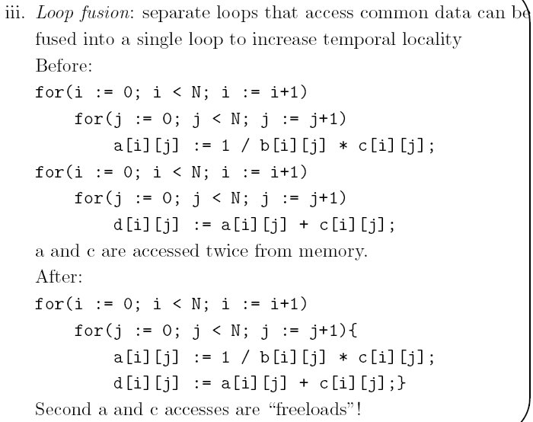
Reducing Cache Misses:
5. Compiler Optimizations

Slide 76
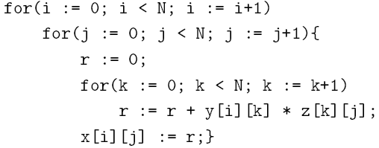
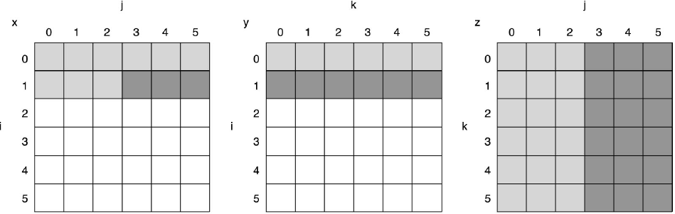
Reducing Cache Misses:
5. Compiler Optimizations
Blocking: improve temporal and spatial locality
  multiple arrays are accessed in both ways (i.e., row-major and column-major), namely, orthogonal accesses that can not be helped by earlier methods
  concentrate on submatrices, or blocks
  All N*N elements of Y and Z are accessed N times and each element of X is accessed once. Thus, there are N³ operations and 2N³ + N² reads! Capacity misses are a function of N and cache size in this case.

Slide 77
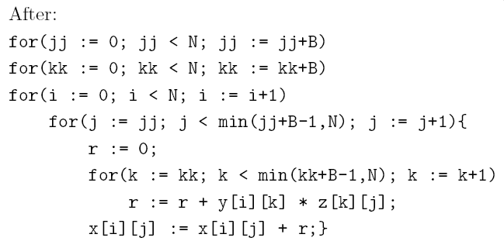
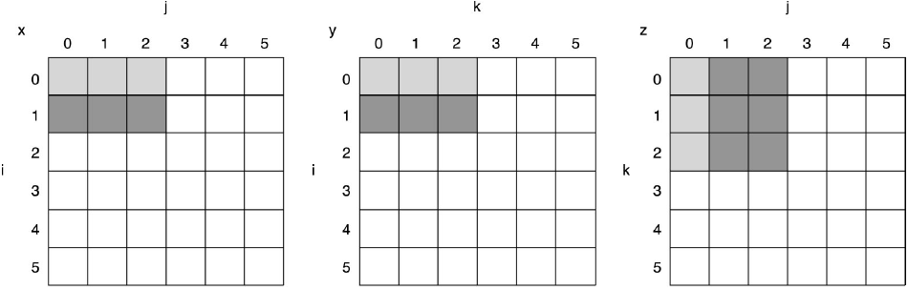
Reducing Cache Misses:
5. Compiler Optimizations
Blocking: improve temporal and spatial locality
  To ensure that elements being accessed can fit in the cache, the original code is changed to compute a submatrix of size B*B, where B is called the blocking factor.
  To total number of memory words accessed is 2N^{3/}/B + N²
  Blocking exploits a combination of spatial (Y) and temporal (Z) locality.

Slide 78
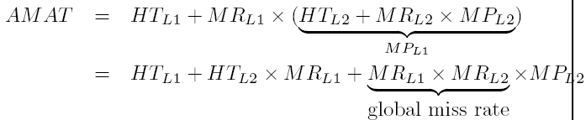
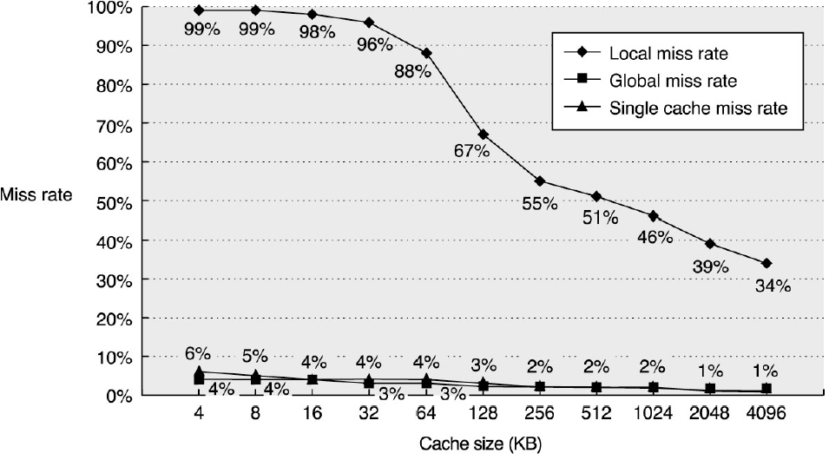
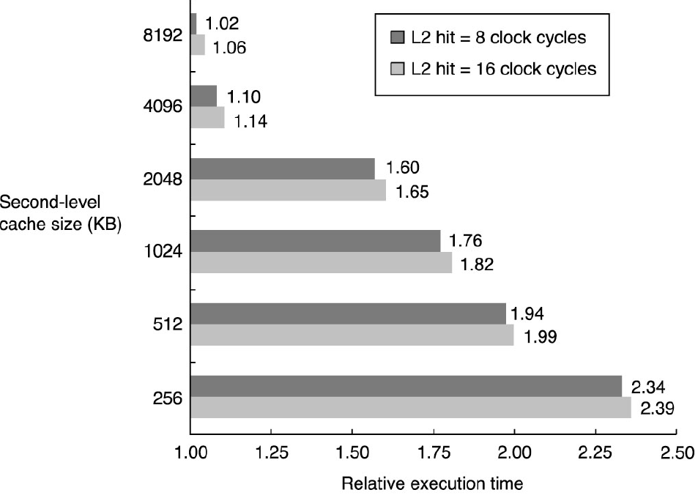
Reducing Cache Miss Penalty:
1. Multi-level Cache
  To keep up with the widening gap between CPU and main memory, try to:
    make cache faster, and
    make cache larger
  by adding another, larger but slower cache between cache and the main memory.

Slide 79
Adding an L2 Cache
If a direct mapped cache has a hit rate of 95%, a hit time of 4 ns, and a miss penalty of 100 ns, what is the AMAT?
If an L2 cache is added with a hit time of 20 ns and a hit rate of 50%, what is the new AMAT?

Slide 80
Adding an L2 Cache
If a direct mapped cache has a hit rate of 95%, a hit time of 4 ns, and a miss penalty of 100 ns, what is the AMAT?
  AMAT = Hit time + Miss rate x Miss penalty = 4 + 0.05 x 100 = 9 ns
If an L2 cache is added with a hit time of 20 ns and a hit rate of 50%, what is the new AMAT?
  AMAT = Hit Time_{L1} + Miss Rate_{L1} x (Hit Time_{L2} + Miss Rate_{L2} x Miss Penalty_{L2} )
  =4 + 0.05 x (20 + 0.5x100) = 7.5 ns

Slide 81

Reducing Cache Miss Penalty:
2. Handling Misses Judiciously
Critical Word First and Early Restart
  CPU needs just one word of the block at a time:
    critical word first: fetch the required word first, and
    early start: as soon as the required word arrives, send it to CPU.
Giving Priority to Read Misses over Write Misses
  Serves reads before writes have been completed:
    while write buffers improve write-through performance, they complicate memory accesses by potentially delaying updates to memory;
    instead of waiting for the write buffer to become empty before processing a read miss, the write buffer is checked for content that might satisfy the missing read.
    in a write-back scheme, the dirty copy upon replacing is first written to the write buffer instead of the memory, thus improving performance.

Slide 82
Reducing Cache Miss Penalty:
3. Compiler-Controlled Prefetching
  Compiler inserts prefetch instructions
  An Example
  for(i:=0; i<3; i:=i+1)
  for(j:=0; j<100; j:=j+1)
  a[i][j] := b[j][0] * b[j+1][0]
    16-byte blocks, 8KB cache, 1-way write back, 8-byte elements; What kind of locality, if any, exists for a and b?
      3 100-element rows (100 columns) visited; spatial locality: even-indexed elements miss and odd-indexed elements hit, leading to 3*100/2 = 150 misses
      101 rows and 3 columns visited; no spatial locality, but there is temporal locality: same element is used in i^{th} and (i + 1)^{st} iterations and the same element is access in each i iteration (outer loop). 100 misses for i = 0 and 1 miss for j = 0 for a total of 101 misses
    Assuming large penalty (50 cycles and at least 7 iterations must be prefetched). Splitting the loop into two, we have

Slide 83
Reducing Cache Miss Penalty:
3. Compiler-Controlled Prefetching
  An Example (continued)
  for(j:=0; j<100; j:=j+1){
  prefetch(b[j+7][0];
  prefetch(a[0][j+7];
  a[0][j] := b[j][0] * b[j+1][0];};
  for(i:=1; i<3; i:=i+1)
  for(j:=0; j<100; j:=j+1){
  prefetch(a[i][j+7];
  a[i][j] := b[j][0] * b[j+1][0]}
    Assuming that each iteration of the pre-split loop consumes 7 cycles and no conflict and capacity misses, then it consumes a total of 7*300 + 251*50 = 14650 cycles (total iteration cycles plus total cache miss cycles);

Slide 84
Reducing Cache Miss Penalty:
3. Compiler-Controlled Prefetching
  An Example (continued)
    the first loop consumes 9 cycles per iteration (due to the two prefetch instruction)
    the second loop consumes 8 cycles per iteration (due to the single prefetch instruction),
    during the first 7 iterations of the first loop array a incurs 4 cache misses,
    array b incurs 7 cache misses,
    during the first 7 iterations of the second loop for i = 1 and i = 2 array a incurs 4 cache misses each
    array b does not incur any cache miss in the second split!.
    the split loop consumes a total of (1+1+7)*100+(4+7)*50+(1+7)*200+(4+4)*50 = 3450
    Prefetching improves performance: 14650/3450=4.25 folds

Slide 85
Reducing Cache Hit Time:
Small and simple caches
  smaller is faster:
    small index, less address translation time
    small cache can fit on the same chip with CPU
    low associativity: in addition to a simpler/shorter tag check, 1-way cache allows overlapping tag check with transmission of data which is not possible with any higher associativity!
Avoid address translation during indexing
  Make the common case fast:
    use virtual address for cache because most memory accesses (more than 90%) take place in cache, resulting in virtual cache

Slide 86
Reducing Cache Hit Time:
  Make the common case fast (continued):
    there are at least three important performance aspects that directly relate to virtual-to-physical translation:
      improperly organized or insufficiently sized TLBs may create excess not-in-TLB faults, adding time to program execution time
      for a physical cache, the TLB access time must occur before the cache access, extending the cache access time
      two-line address (e.g., an I-line and a D-line address) may be independent of each other in virtual address space yet collide in the real address space, when they draw pages whose lower page address bits (and upper cache address bits) are identical
    problems with virtual cache:
      Page-level protection must be enforced no matter what during address translation (solution: copy protection info from TLB on a miss and hold it in a field for future virtual indexing/tagging)
      when a process is switched in/out, the entire cache has to be flushed out ‘cause physical address will be different each time, i.e., the problem of context switching (solution: process identifier tag -- PID)

Slide 87
Reducing Cache Hit Time:
Avoid address translation during indexing (continued)
    problems with virtual cache:
      different virtual addresses may refer to the same physical address, i.e., the problem of synonyms/aliases
        HW solution: guarantee every cache block a unique phy. Address
        SW solution: force aliases to share some address bits (e.g., page-coloring)
        Virtually indexed and physically tagged
Pipelined cache writes
  the solution is to reduce CCT and increase # of stages – increases instr. throughput
Trace caches
  Finds a dynamic sequence of instructions including taken branches to load into a cache block:
    Put traces of the executed instructions into cache blocks as determined by the CPU
    Branch prediction is folded in to the cache and must be validated along with the addresses to have a valid fetch.
    Disadvantage: store the same instructions multiple times

Slide 88
Cache Performance Measures
Hit rate: fraction found in the cache
  So high that we usually talk about Miss rate = 1 - Hit Rate
Hit time: time to access the cache
Miss penalty: time to replace a block from lower level, including time to replace in CPU
  access time: time to access lower level
  transfer time: time to transfer block
Average memory-access time (AMAT)
= Hit time + Miss rate x Miss penalty (ns or clocks)

Slide 89
Cache performance
Miss-oriented Approach to Memory Access:
  CPI_{Execution} includes ALU and Memory instructions
Separating out Memory component entirely
  AMAT = Average Memory Access Time
  CPI_{ALUOps} does not include memory instructions

Slide 90
Calculating AMAT
If a direct mapped cache has a hit rate of 95%, a hit time of 4 ns, and a miss penalty of 100 ns, what is the AMAT?
If replacing the cache with a 2-way set associative increases the hit rate to 97%, but increases the hit time to 5 ns, what is the new AMAT?

Slide 91
Calculating AMAT
If a direct mapped cache has a hit rate of 95%, a hit time of 4 ns, and a miss penalty of 100 ns, what is the AMAT?
  AMAT = Hit time + Miss rate x Miss penalty = 4 + 0.05 x 100 = 9 ns
If replacing the cache with a 2-way set associative increases the hit rate to 97%, but increases the hit time to 5 ns, what is the new AMAT?
  AMAT = Hit time + Miss rate x Miss penalty = 5 + 0.03 x 100 = 8 ns

Slide 92
Impact on Performance
Suppose a processor executes at
  Clock Rate = 200 MHz (5 ns per cycle), Ideal (no misses) CPI = 1.1
  50% arith/logic, 30% ld/st, 20% control
Suppose that 10% of data memory operations get 50 cycle miss penalty
Suppose that 1% of instructions get same miss penalty
Calculate AMAT?

Slide 93
Impact on Performance
Suppose a processor executes at
  Clock Rate = 200 MHz (5 ns per cycle), Ideal (no misses) CPI = 1.1
  50% arith/logic, 30% ld/st, 20% control
Suppose that 10% of data memory operations get 50 cycle miss penalty
Suppose that 1% of instructions get same miss penalty
CPI = ideal CPI + average stalls per instruction 1.1(cycles/ins) +
[ 0.30 (DataMops/ins) x 0.10 (miss/DataMop) x 50 (cycle/miss)] +
[ 1 (InstMop/ins) x 0.01 (miss/InstMop) x 50 (cycle/miss)]
= (1.1 + 1.5 + .5) cycle/ins = 3.1
AMAT=(1/1.3)x[1+0.01x50]+(0.3/1.3)x[1+0.1x50]=2.54

Slide 94
Unified vs Split Caches
Unified vs Separate I&D
Example:
  16KB I&D: Inst miss rate=0.64%, Data miss rate=6.47%
  32KB unified: Aggregate miss rate=1.99%
Which is better (ignore L2 cache)?
  Assume 33% data ops ⇒ 75% accesses from instructions (1.0/1.33)
  hit time=1, miss time=50
  Note that data hit has 1 stall for unified cache (only one port)
Proc
Proc
Proc
Unified
Cache-1
I-Cache-1
D-Cache-1
Unified
Cache-2
Unified
Cache-2

Slide 95
Unified vs Split Caches
Unified vs Separate I&D
Example:
  16KB I&D: Inst miss rate=0.64%, Data miss rate=6.47%
  32KB unified: Aggregate miss rate=1.99%
Which is better (ignore L2 cache)?
  Assume 33% data ops ⇒ 75% accesses from instructions (1.0/1.33)
  hit time=1, miss time=50
  Note that data hit has 1 stall for unified cache (only one port)
AMAT_{Harvard}=75%x(1+0.64%x50)+25%x(1+6.47%x50) = 2.05
AMAT_{Unified}=75%x(1+1.99%x50)+25%x(1+1+1.99%x50)= 2.24
Proc
Proc
Proc
Unified
Cache-1
I-Cache-1
D-Cache-1
Unified
Cache-2
Unified
Cache-2

Slide 96
Cache Performance Summary
AMAT = Hit time + Miss rate x Miss penalty
Split vs. Unified Cache
3C’s of misses
  compulsory
  capacity
  conflict
Methods for improving performance
  Reduce miss rate: increase cache size, block size, associativity, compiler optimization, way-prediction, victim cache, etc.
  Reduce miss penalty: multi-level cache, handling misses judiciously, compiler-controlled prefetching, etc.
  Reduce hit time: smaller and simpler caches, avoiding address translation in indexing, pipelining cache writes, trace cache, etc.

